Slide 1
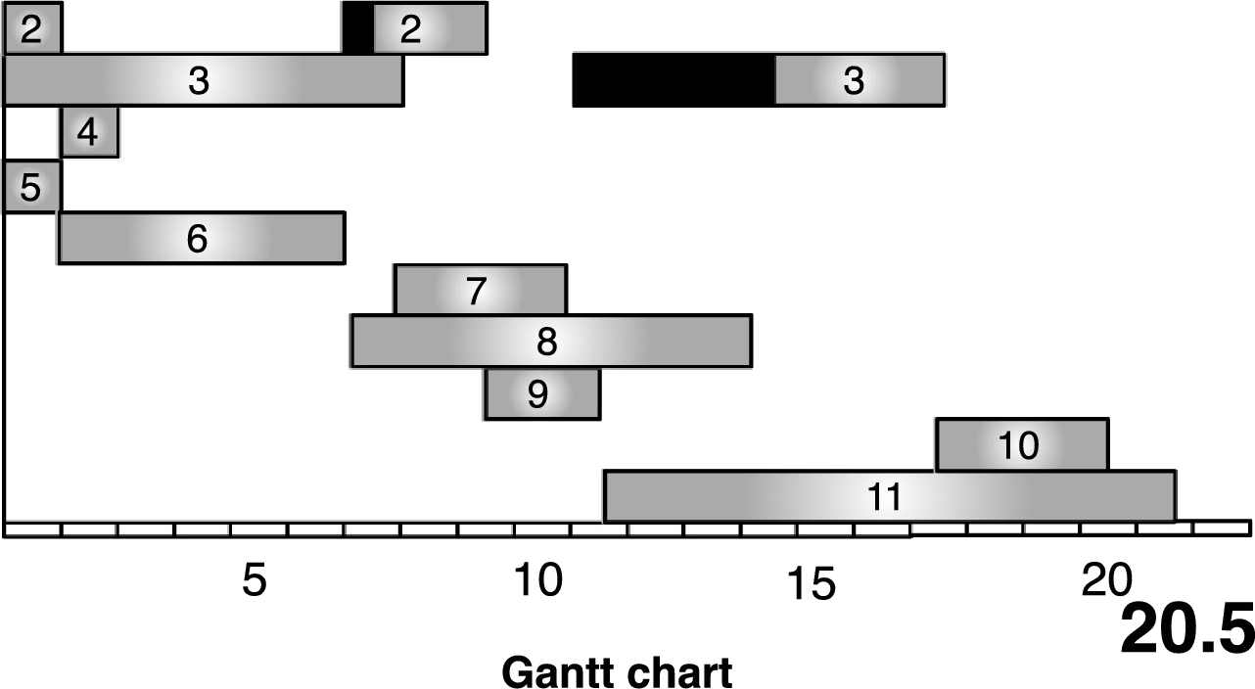
Heuristic resource-constrained project scheduling with task preemption and setup times
25/04/2022
Sourced Vanhoucke & Coelho (2019)

Slide 2
Preemption and setup times
The preemptive resource-constrained project scheduling problem with setup times (PRCPSP-ST):
Input is the same as standard resource-constrained project scheduling problems (RCPSP)
A task can be split into integer time parts
Each activity segment is penalized by an setup time except the first segment
The model must be extended for both splits and setup times
When modelled correctly any general RCPSP algorithm can be applied to the extended model

Slide 3
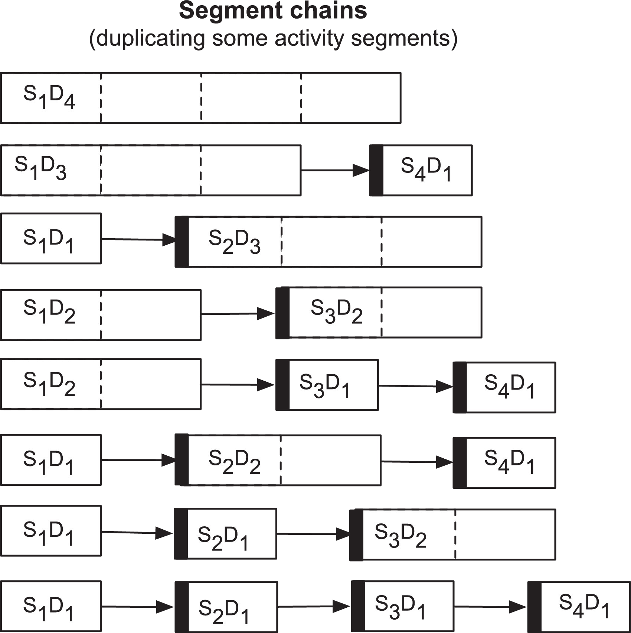
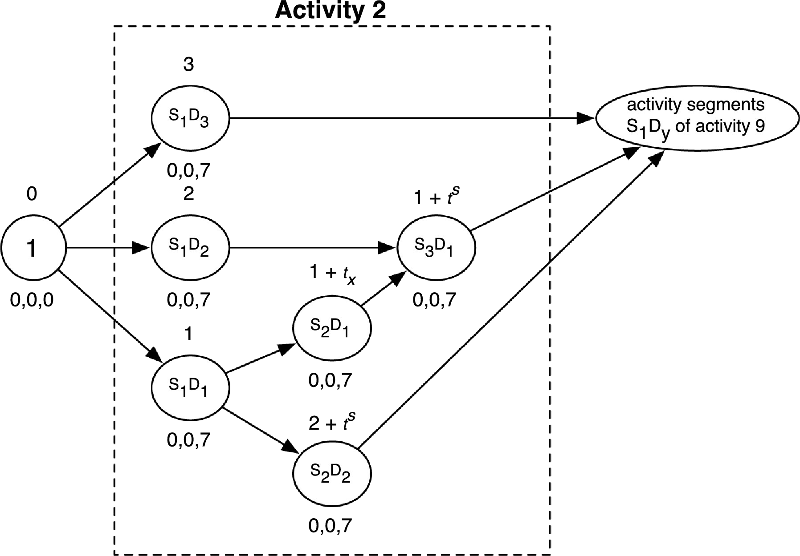
Extended model
An activity node in the network can be replaced by segment chains that model all possible ways to split a task
Because tasks can only be split at integer time intervals the amount of segment chains is finite
Each segment that does not start with the first segment gets additional setup time added
The resulting network is no different than a standard RCPSP network with more activity nodes
Sourced Vanhoucke & Coelho (2019)
09-10-2020
Sourced Vanhoucke & Coelho (2019)

Slide 4
Role of the SAT solver
A SAT solver will select a subset of activity segments that makes sure each segment is only selected once
From the selected segments another algorithm like an altered branch-and-bound can make a schedule
This algorithm must try to minimize the makespan of the schedule as this will be used as the objective
The SAT solver segment selection is where a heuristic can be implemented
Choosing the right segments here could result in a lower makespan after schedule construction
Adapted from Vanhoucke & Coelho (2019)
09-10-2020

Slide 5
Thanks for your attention
Jasper Vermeulen

Slide 6
References
Mario Vanhoucke and José Coelho. Resource-constrained project scheduling with activity splitting and setup times. Computers Operations Research, 109:230249, 2019.

